Slide 1

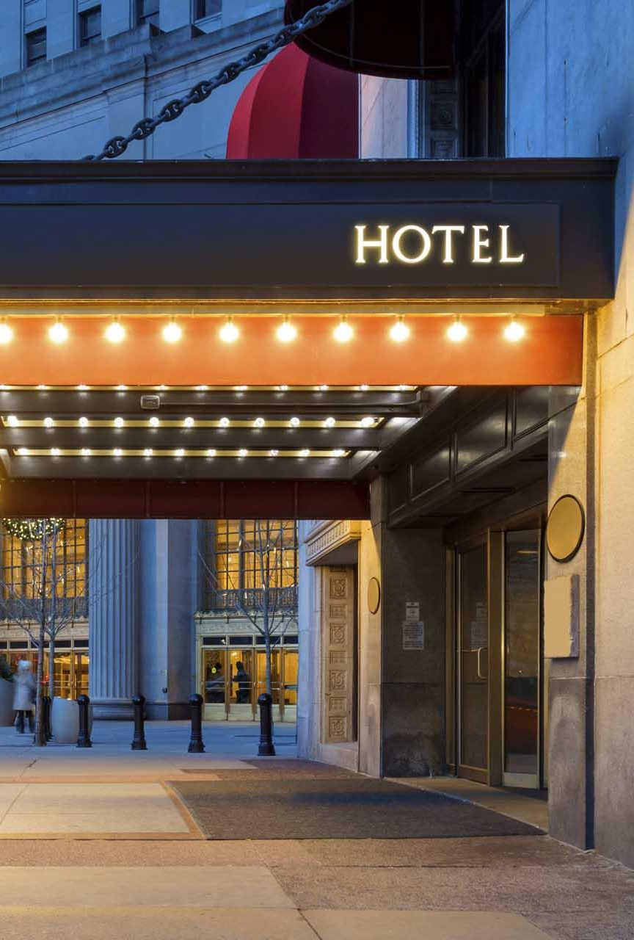
Do Higher Hospitality Wages mean Better Hotel Guest Satisfaction?
Paula Vasques, Anna Zvanskaya, Sharanya Srinivas, Summer Kao, Pushan Parihar

Slide 2
Hotel reviews are one of the main criteria for travelers while choosing their stay. If wages are related to quality of service, this means that, for the stakeholder, higher wages are an investment.
This research supports stakeholder decision making.
Why We Chose This Topic:

Slide 3
Research Question and Hypothesis:
Research question:
Hypotheses:
H₀: no relationship between wages and ratings.
H₁: higher hospitality wages are associated with higher ratings.
Is there a correlation between hospitality employee wages and customer satisfaction?

Slide 4
Data Sources & Methodology:
Data Sources
Hotel reviews: 55,912 reviews from three CSV files
Wage data: 434,473 wage records from a BLS Excel file
Main variables included are: hotel satisfaction ratings (1-5), written reviews, review date, state, and hospitality employee occupation and annual wage
Methodology
Cleaned 55,698 hotel reviews
Merged reviews by state and year
Cleaned 434,473 rows of hospitality employee wage data
Used keywords to study the nature of complaints and compared them with wages and ratings

Slide 5
To explore this problem and develop an analysis for the core issue, we asked questions and answered them with data

Slide 6
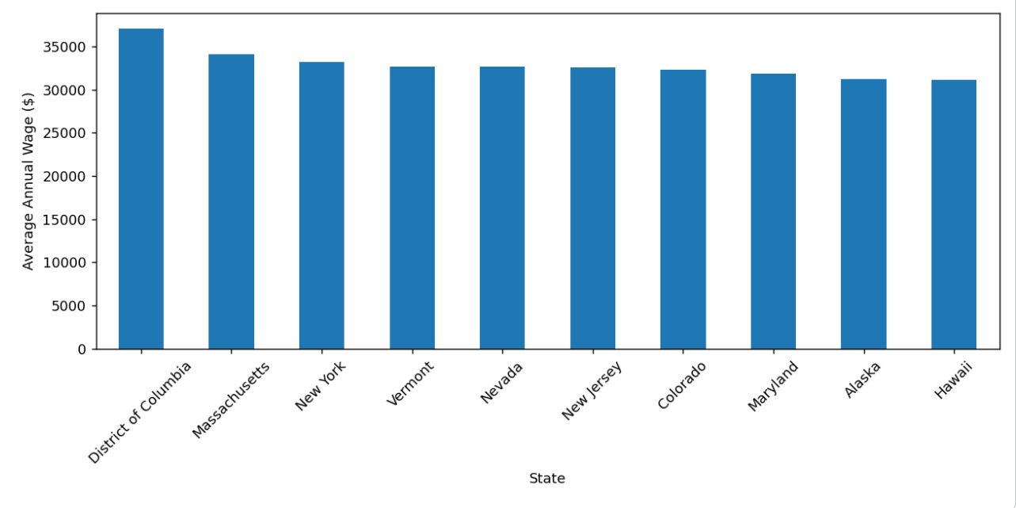
Which U.S. States have the highest average hospitality wages ?
Method:
Ranked locations by average annual wages across selected hospitality occupations
Key findings:
D.C. had the highest average wage
The top 10 states in average wages did not differ that much between them

Slide 7
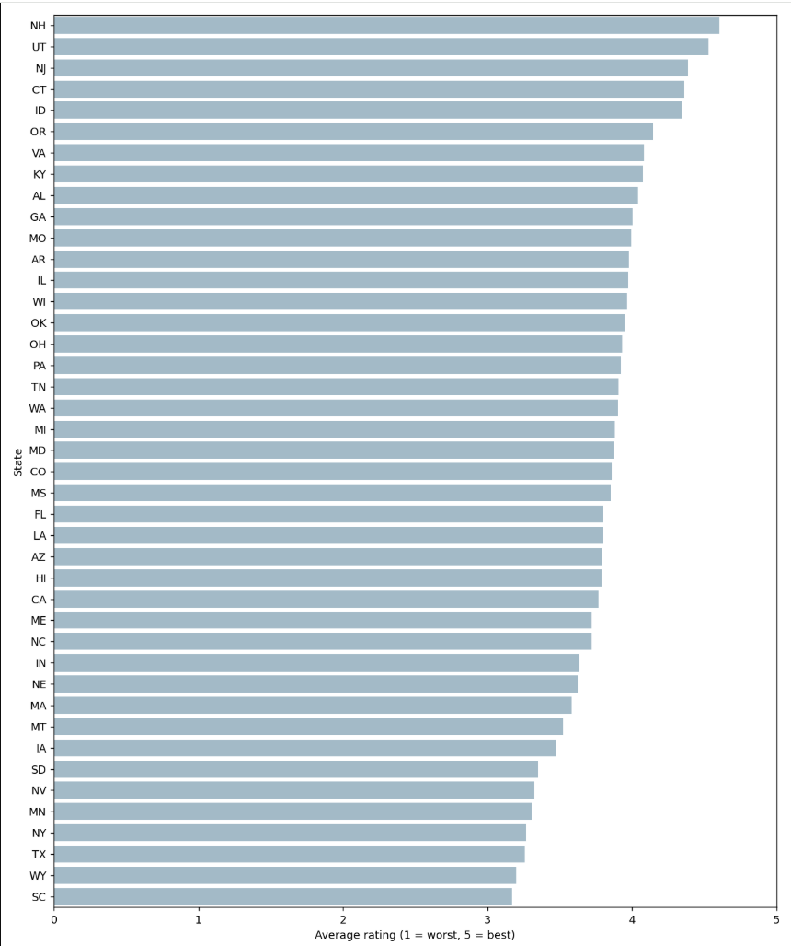
Which states in the U.S. the hotel ratings are highest and lowest ?
Method:
Compared average hotel ratings across 42 states with at least 100 reviews
Key findings:
Highest wages, did not correlate with highest rates
Highest: New Hampshire, Utah and New Jersey
Lowest: South Carolina, Wyoming and Texas
Overall average: 3.78/5

Slide 8
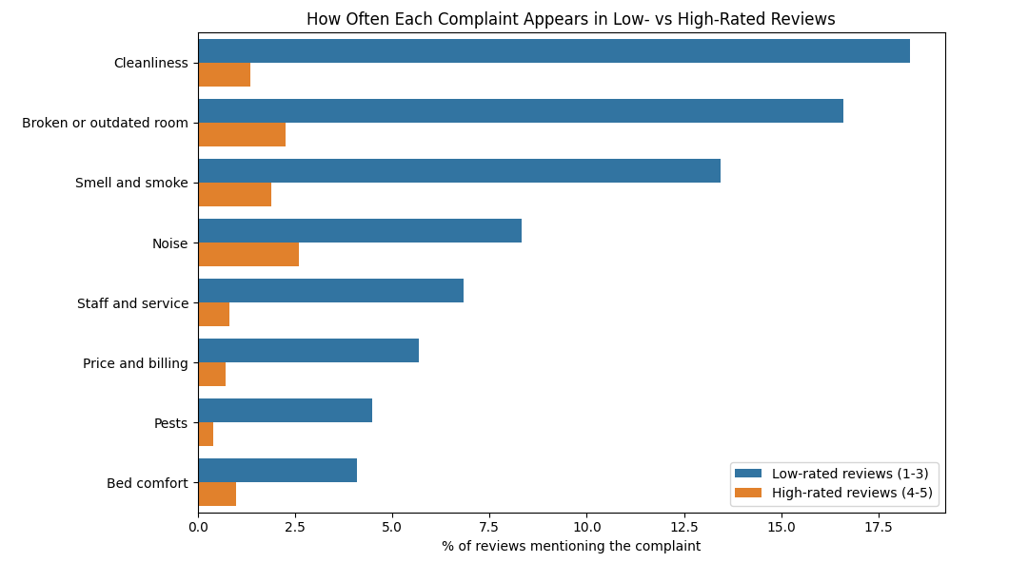
How often categories of complaint appear in reviews with low vs high ratings
Method:
Compared complaint keywords in low-rated and high-rated reviews
Key findings:
Cleanliness appeared most often in low-rated reviews
Broken/outdated rooms and smell/smoke followed
Complaint keywords appeared in 48.2% of low-rated reviews versus 9.4% of high-rated reviews

Slide 9
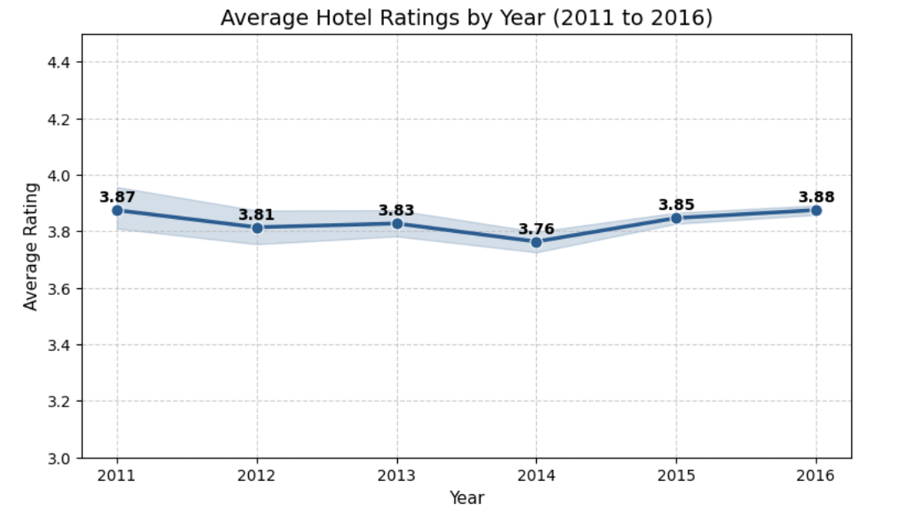
How have average hotel customer ratings evolved over
the years?
Method:
Calculated yearly average ratings using the legacy hotel-review dataset
Key findings:
Highest average: 3.88 in 2016
Lowest average: 3.76 in 2014
Satisfaction remained relatively stable

Slide 10
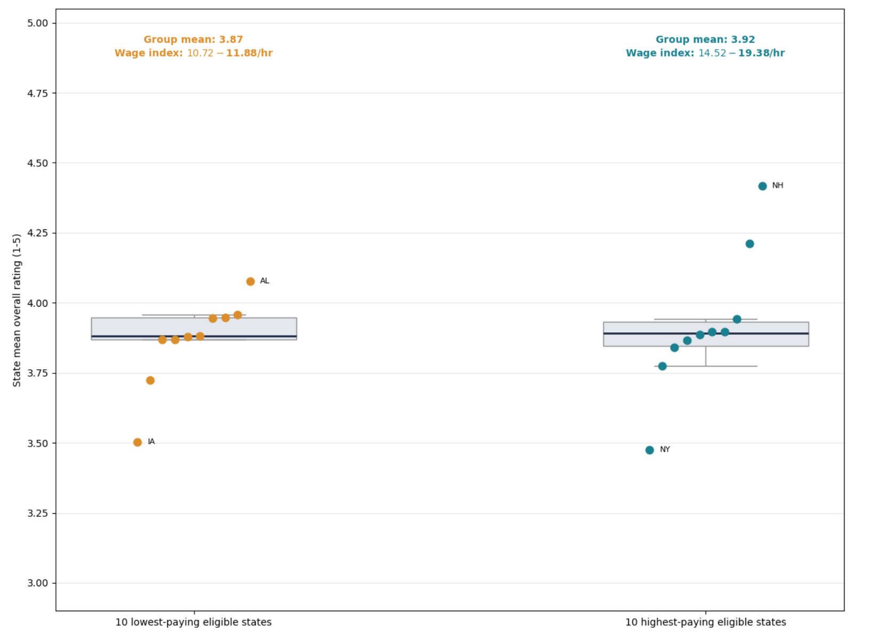
Higher Pay Did Not Mean Higher Ratings
Method:
Ranked the 42 states by a wage index: the average hourly wage of six hotel jobs
Compared average hotel ratings for the 10 highest- and 10 lowest-paying states
Key Finding:
Highest-paying states averaged 3.92, lowest-paying 3.87
Ratings vary far more within each group than between them
Higher pay alone did not translate into meaningfully better ratings

Slide 11
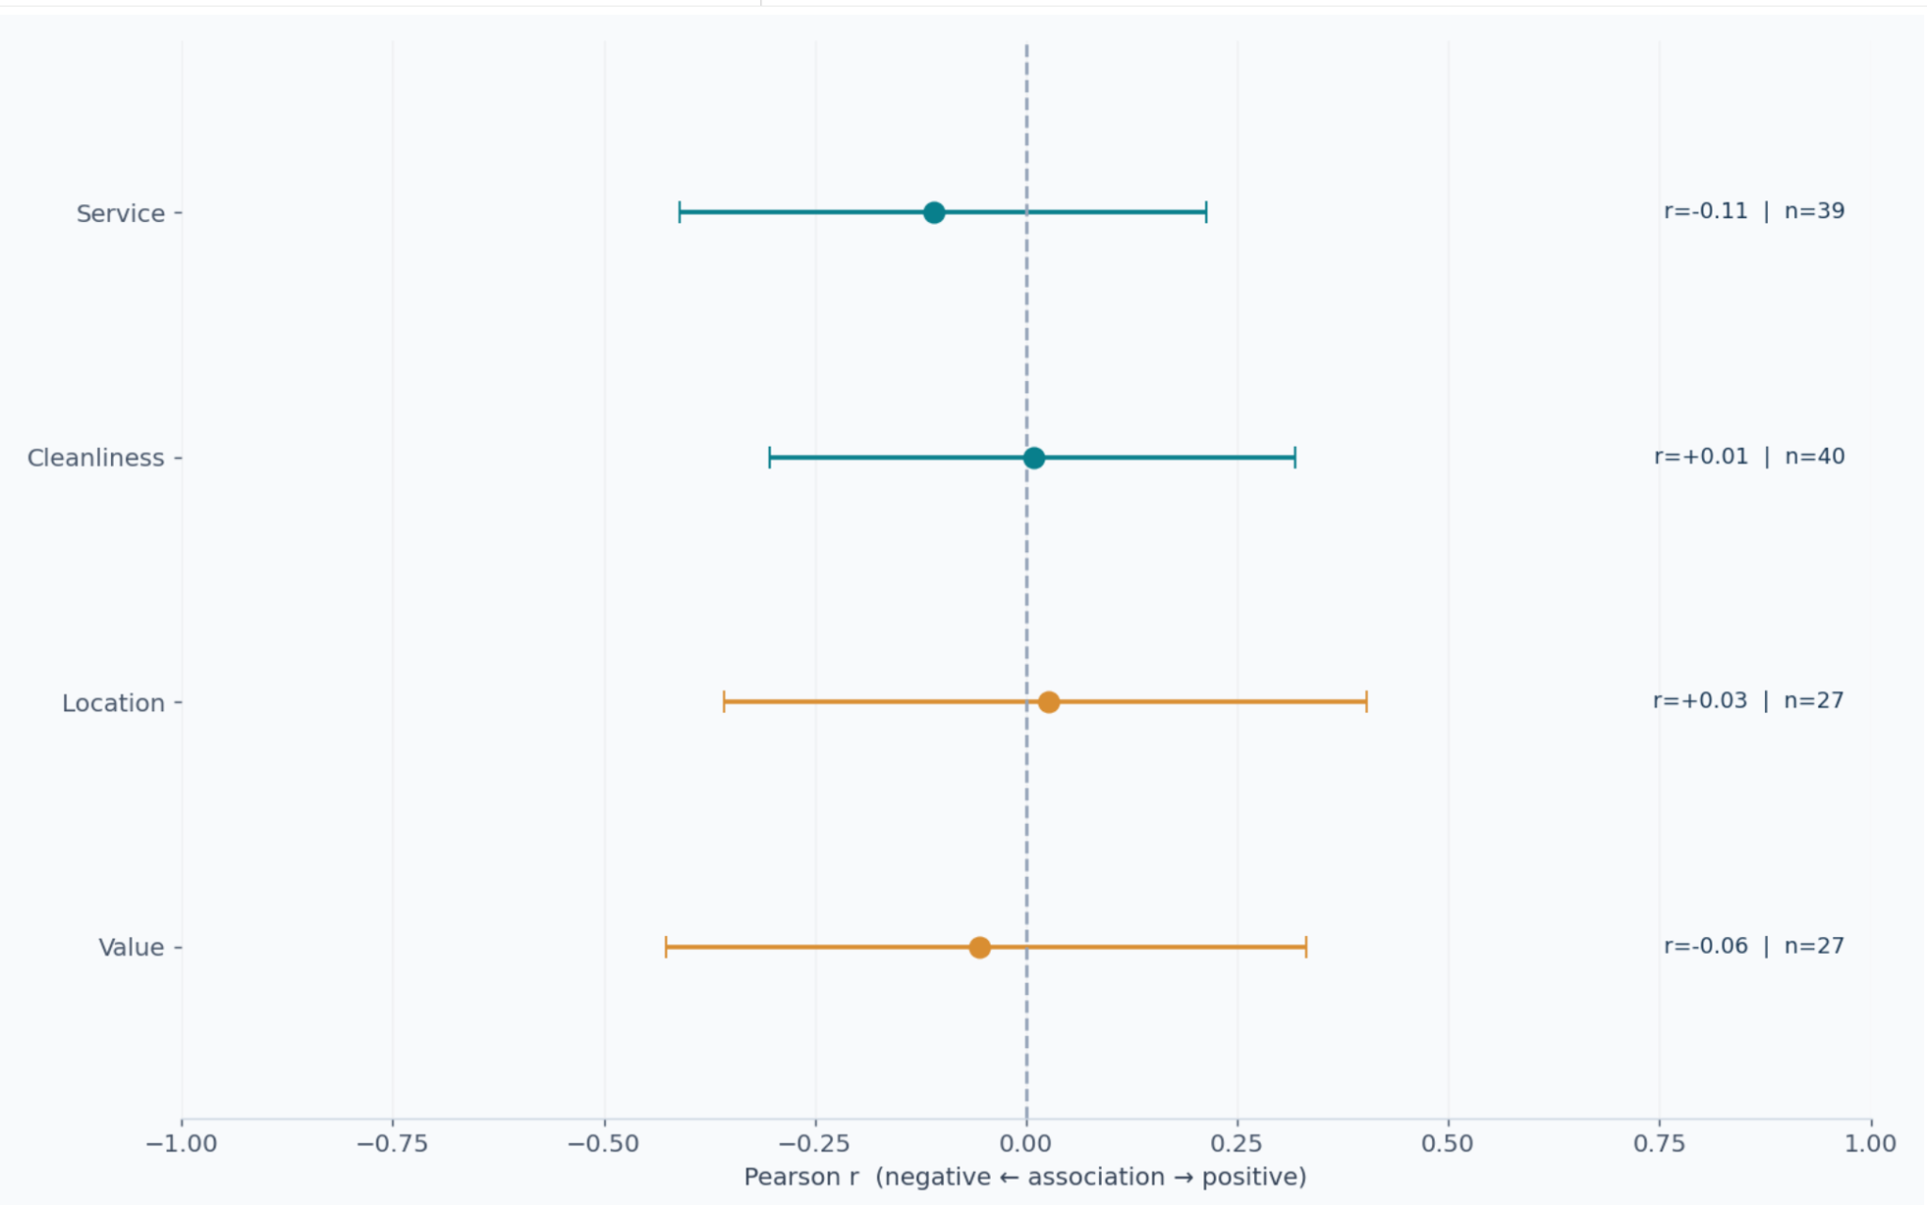
Wages Were Not Strongly Linked to Any Review Category
Method:
Compared wages and ratings across four topics
Measured how closely they were related
Key Finding:
Wage and ratings had weak relationships
No topic showed a clearly stronger connection

Slide 12
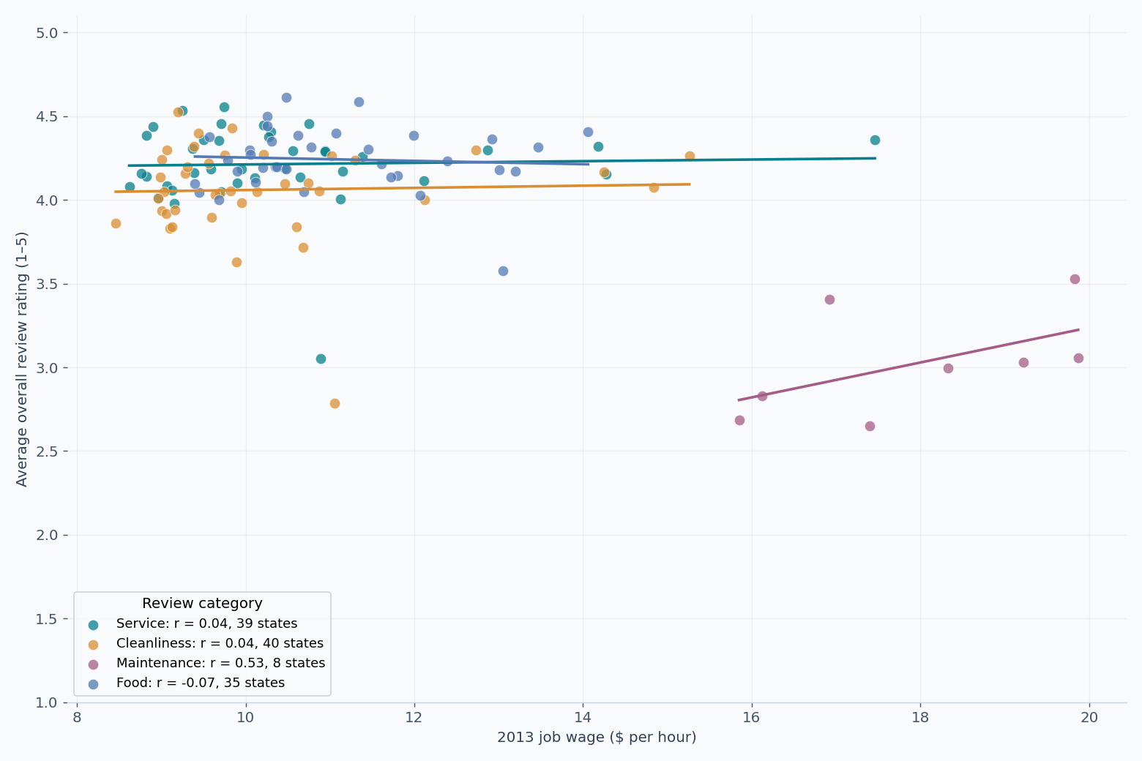
Higher Occupation Wages Do Not Consistently Lead to Higher Ratings
Method:
Compared wages and ratings by work area
Calculated their correlation using state-level data
Key Findings:
Relationships were weak and inconsistent
Higher wages did not guarantee better ratings

Slide 13
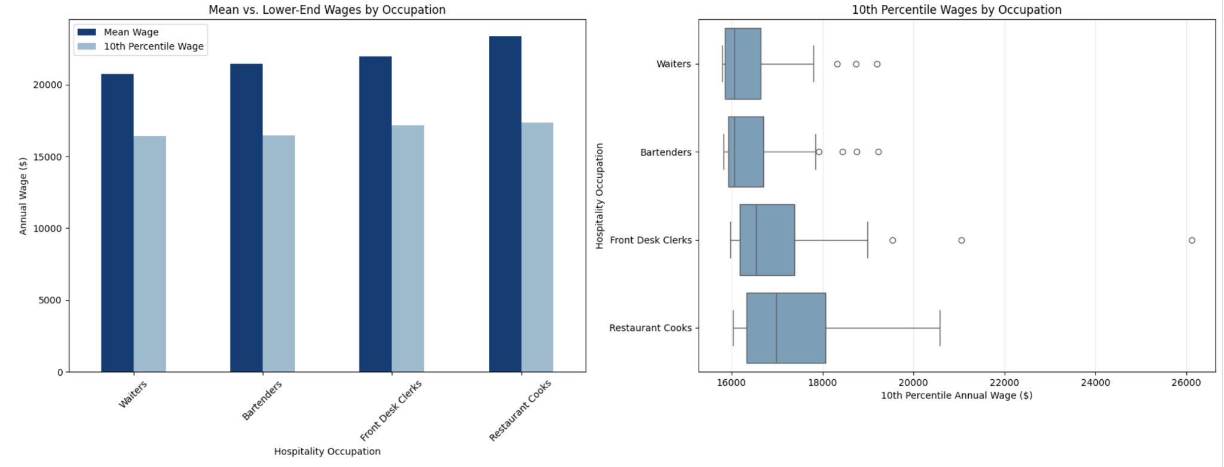
Hospitality Wage Differs Across Occupation
Method:
Compared average wages and 10th percentile wages on occupations
Filtered lowest paid hospitality wages
Key Finding:
Many outliers that affect the mean
Restaurant cooks highest paid at $23000 and Waiters lowest paid at $21000

Slide 14
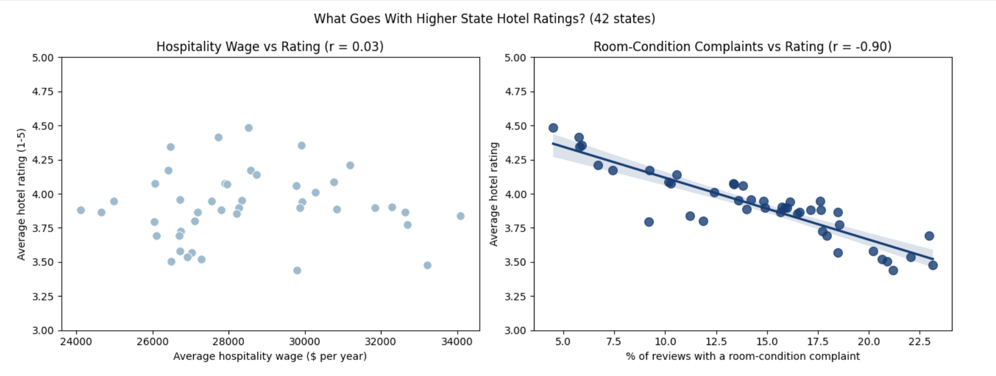
Room Complaints Matter More Than Wages
Method:
Compared wages, hotel ratings, and room complaints across 42 states
Measured their relationships using correlation
Key Findings:
Wage–rating correlation: −0.03
Room complaints–rating correlation: −0.89
Room complaints had a much stronger link to lower ratings than wages

Slide 15
Conclusion
Higher wages had a weak link to hotel ratings
Room complaints had a stronger link to lower ratings.
Cleanliness and other room related conditions were key guest concerns.
Improving room conditions is one of the ways to improve guest satisfaction.

